Slide 1
A Visual Workspace for Polyphonic Texture-Writing
Owen Cannon
New York University, owen.cannon@nyu.edu

Slide 2
Objectives
Introduce musical precepts of the western classical tradition
Expose students, educators, and individual users to logic programming and visual programming in connection to polyphonic music of the western classical tradition
Enable creative applications of multi-voice textural motion
Invite new approaches to multi-voice textures in new music

Slide 3
‘gradus ad parnassum’
From the List of Works entitled ‘Gradus ad Parnassum’ on Wikipedia:
The Latin phrase gradus ad Parnassum means "steps to Parnassus". It is sometimes shortened to gradus. The name Parnassus was used to denote the loftiest part of a mountain range in central Greece, a few miles north of Delphi, of which the two summits, in Classical times, were called Tithorea and Lycoreia. In Greek mythology, one of the peaks was sacred to Apollo and the nine Muses, the inspiring deities of the arts, and the other to Dionysus.[1]The phrase has often been used to refer to various books of instruction, or guides, in which gradual progress in literature, language instruction, music, or the arts in general, is sought.

Slide 4
Summary of Main Rules for 1st-Species Counterpoint
The counterpoint must begin and end on a perfect consonance.
Contrary motion should predominate.
Perfect consonances must be approached by oblique or contrary motion.
Imperfect consonances may be approached by any type of motion.
The interval of a tenth should not be exceeded between two adjacent parts unless by necessity.

Slide 5
Nested List Structure for Representing Note-to-Note Motion
Generated variables, representing a range of possible values, combined with the list corresponding to the main theme, comprise a nested list structure that is referred to as a sequence throughout in the music-conversion environment. Each list at the top level of a sequence corresponds to a voice in a polyphonic texture.

Slide 6

Data Structures for Note-to-Note Motion
Notated representation of the list structure for MIDI notes
((74 72 74 … )
(62 69 67 … ))

Slide 7

Data Structures for Note-to-Note Motion
Notated representation of the list structure for MIDI notes
((74 (75 72) 74 … )
(62 69 67 … ))

Slide 8
Data Structures for Note-to-Note Motion in 2nd species
The mat-trans or matrix-transpose function reorients nested list structures to give a list of all of the simultaneities in a multivoice-texture. For example, the second-species sequence
((74 (75 72) 74 … )
(62 69 67 … )) appears as follows after transposition:
 | Interval (Chromatic) | Interval (Diatonic)
(62 74) | 8 | 12
(69 75) | 6 | 8
(69 72) | 3 | 3
(67 74) | 5 | 7
(mat-trans
(flatten-seqc
‘((74 (75 72) 74 … )
(62 69 67 … ))

Slide 9
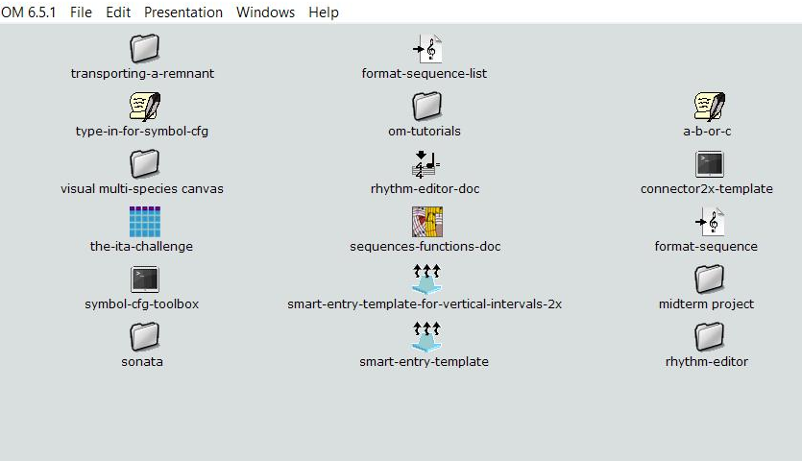
Main Program Window
This patch window contains folders and items related to example projects.

Slide 10
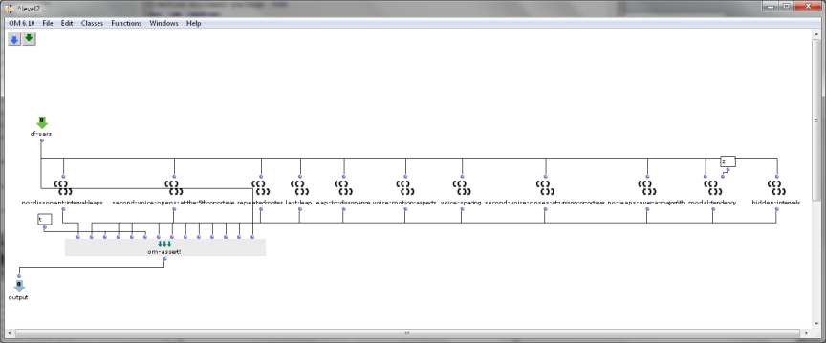
Patch Window
This patch window applies specific rules to variables representing sequences of notes using MIDI numbers

Slide 11
Limitations of the Logic Programming Approach
Rules are ‘all-or-nothing’
Does not take into account precepts of species counterpoint such as melodic arch & contrast between voices

Slide 12
Points System

Slide 13
Other Resources on Logic Programming and Musical Polyphony
‘CounterpointService’ – https://counterpointservice.cfapps.io/
Introductory material on openmusictheory: http://openmusictheory.com/cantusFirmus.html http://openmusictheory.com/firstSpecies.html

